Slide 1
Decision Making behaviour for Cognitive agent-based Model in Crowd Simulation from Real-time Data
Brief Background
Social-force model and its limitation (Helbing, 1995 & Helbing 2000 & Helbing 2014)
Steering Behaviour Effect (Reynolds, 1999)
Agent-base models with Belief-Desire-Intention agents (Georgeff, 1989)
Cognitive architecture theory (Anderson 1998 & Anderson,2007) and Physiology structure (Newell, 1990)
Chronological literature reviews on Force Cognitive Agent-based model
Simulate virtual crowds in emergency situations (Braun, 2003)
Crowd Simulation Incorporating Agent Psychological Models, Roles, Communication (Pelechano, 2006)
A pedestrian model for shopping mall case study (Xi, 2010)
Cognitive and heuristic rules (Moussaid, 2011)
A Configurable Agent-Based Crowd Model with Generic Behavior Effect (Sun, 2014)
CROSS: Modelling Crowd Behavior with Social-Cognitive Agents (Wijermans, 2013)
Research Questions
Force cognitive agent-based model for temporal route choice inspired by the latest survey on Crowd Model research (Hoodgendoorn, 2013) and biological models (Couzin, 2013) & (Loreto, 2013)
Measure effect of force cognitive agent-based model’s parameters by actual data acquisition
Aims
Research Methodology
Propose model
Data Acquisition Techniques
Reference

Slide 2
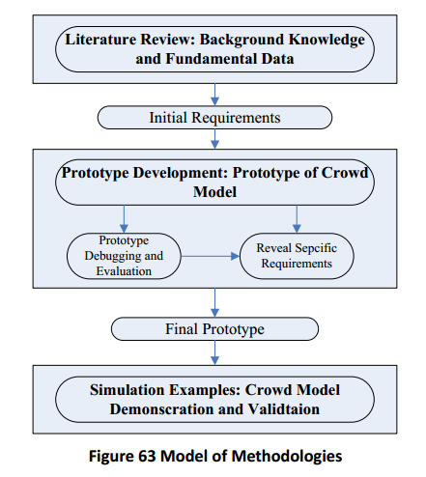
physiology
perception
memory
behaviour selection
Processes

Slide 3
Scope
Crowd Density, Crowd Mobility, Direction
Macro
Motion-based flow, self-organization phenomena (turbulence)
Behaviour of flock
Meso
Micro
Velocity, trajectory, position
Sensors in Action
Sensor in Action
Collaboration
Detection
Inferring
Pre-processing
Simulation
Big Data Architecture
Evacuation
Crowd Sensors
Camera
Mobile Sensing

Slide 4
Cell length is a geographical area defined by GPS coordinates
4x4
4x4
o3
o6
o1
o5
o7
o2
o1
o5
o3
o2
o6
o7
o4
o4
When does the lane formation between cell C2,4 and C4,1 occur and during how long
Pressure C1,1 = 0
Pressure C1,1 = 1
Pressure C2,4 = 2
Pressure C4,1 = 5
Pressure C4,4 = 0
Pressure C2,4 = 2
Pressure C4,1 = 2
Pressure C4,1 = 2
t0
t0 + A
t1
Should be masked by Melbourne map and create animation 3D by Myriad II

Slide 5
REAL-TIME DATA ACCQUISTION FOR ADAPTIVE CROWD MODELLING
Outline should be Mindmap about below points.
Crowd Disaster Management
Studies on Crowd Modelling and Simulation (long-time ago)-> Camera surveillance (Reference-recently-2012 in high density)
Crowd Modelling is for 4 purposes-> perform by simulation by understanding
Aims:
Matrices of Crowd Modelling using continous and realtime
Explore temporal information on cells
Proximity influence in panic
Real-time data in emegency condition
Manage vast dataset

Slide 6


Corridor2
v
Corridor4
Corridor1
X
Corridor3

Slide 7
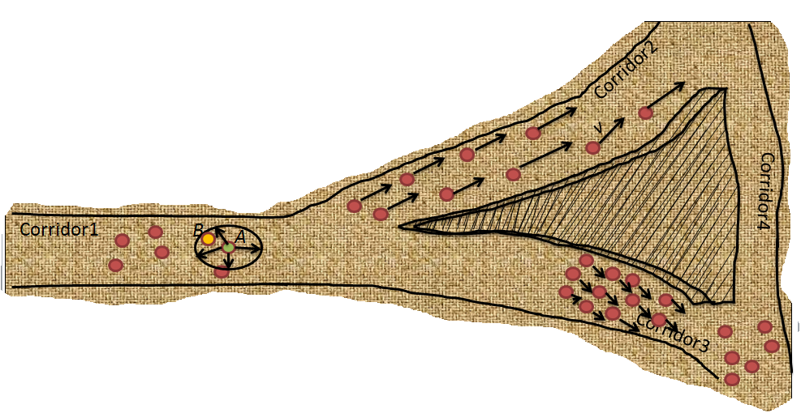

Slide 8
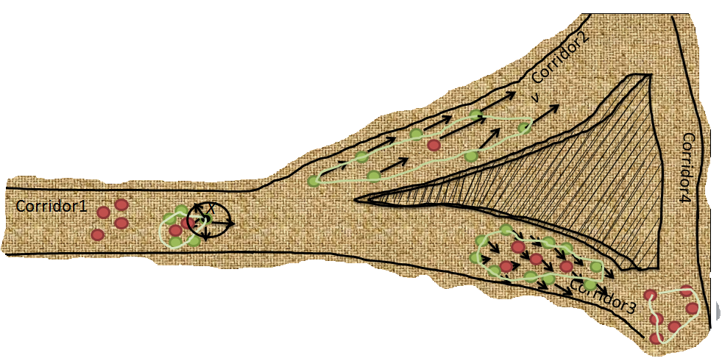

Slide 9
Start
Prepare Agent Information
Retrieve Agent Perception
Decide Desired Behaviour
Identify Passive Behaviours
Next loop
Fail
End
Prepare Agent Information
Update Agent Information
Check Constraint
Calculate and combine Behaviour Effects
Pass
Agent Information
Simulation Environment
Physical Attribute
Crowd Population
Environment
Current Status
Current position
Desired speed
Agent
Wall
Gate
….
Knowledge
Perception: Other agent’s public status and environment
Map: navigation map of route and waypoint.
Obstacles, Walls (length, position, repulsive information
Sign
POIs
….
Obstacles
etc
Agent

Slide 10
Subsistence: preserving energy
Safety: remaining safe
Goal dominance= goal_ satisfaction – goal_perferrence
Each memory element has
content and activation level
Goal
Social: belonging to a group
The more goal dominance is, the more probable a behaviour is chosen to satisfy that goal
Personal : do something individually
Memory
goals, facts, rules
Area fact: POIs, obstacle
Fact activation level is calculated by a neuron function from perception process.
Facts with high activation level is easily retrievable. Facts with low level is for longer retrievable.
Anderson,2007
Personal fact: recognize friends, leaders
Fact
Behaviour fact: convey Expectation value it would be to perform a specific behaviour
When a behavior is activated, it gives a rise to a hierarchy in behavior
Physiology
perception, arousal
Newell,1990
A behaviour rule produces a specific behaviour
The changes in activation over the time is a dynamic ordering of behavior
Rule
Each behavior rule has activation value. It is computed by a neuron function that relates to values of other behavior rules.
Internal Components
Priming
Change activation level of Behaviour Rules in Memory correspondingly from sensors in Physiology
Perception
Physiological Update
From arousal it will involve other context-depending physiological element
Memory Update
Update goals, the degree of satisfaction, expectation making a behaviour more or less suitable
Processes
Behaviour Selection
This process selects suitable behaviour within a certain amount of time.
During this interval, behaviour rules are fetched respectively by activation level. A formula is proposed to compare the relevance of collected behaviour.
Notes:
Cognitive architecture describes internal states and mental processes of an individual to give a behaviour decision at any given moment in time. State memory can be updated over the time by learning, forgetting, re-organising.
Memory: represent agent’s knowledge and processes that allow an individual to interact with its environment. It describes how memory elements become more dominant and change in content.

Slide 11
Decision Making behaviour for Cognitive agent-based Model in Crowd Simulation
Background
Agent-base models with Belief-Desire-Intention agents (Georgeff, 1989)
Cognitive architecture theory (Anderson, 1998 & Anderson, 2007) and Physiology structure (Newell, 1990)
Chronological literature reviews on Force Cognitive Agent-based model
Crowd Simulation Incorporating Agent Psychological Models, Roles, Communication (Pelechano, 2006)
A pedestrian model for shopping mall case study (Xi, 2010)
A Configurable Agent-Based Crowd Model with Generic Behavior Effect (Sun, 2014)
CROSS: Modelling Crowd Behavior with Social-Cognitive Agents (Wijermans, 2013)
Questions and Solution
Force cognitive agent-based model for route choice over the time inspired by biological models (Couzin, 2013) & (Loreto, 2013) and the latest survey of Crowd Modelling (Hoodgendoorn, 2013)
Validate effect of force cognitive agent-based model’s parameters by actual data acquisition
Reference
List of other relevant papers to be read

Slide 12
Agent-based Model with BDI agents (Georgeff, 1989)

Slide 13
Cognitive architecture
Subsistence: preserving energy
Safety: remaining safe
Goal dominance= goal_ satisfaction – goal_perferrence
Goal
The more goal dominance is, the more probable a behaviour is chosen to satisfy that goal
Each memory element has
content and activation level
Social: belonging to a group
Personal : do something individually
Memory
goals, facts, rules
Area fact: POIs, obstacle
Fact activation level is calculated by a neuron function from perception process.
Facts with high activation level is easily retrievable. Facts with low level is for longer retrievable.
(Anderson,2007)
Personal fact: recognize friends, leaders
Fact
Behaviour fact: convey Expectation value it would be to perform a specific behaviour
When a behavior is activated, it gives a rise to a hierarchy in behavior
Physiology
perception, arousal
A behaviour rule produces a specific behaviour
The changes in activation over the time is a dynamic ordering of behavior
(Newell,1990)
Rule
Each behavior rule has activation value. It is computed by a neuron function that relates to values of other behavior rules.
Internal Components
Priming
Change activation level of Behaviour Rules in Memory correspondingly from sensors in Physiology
Perception
Physiological Update
From arousal it will involve other context-depending physiological element
Memory Update
Update goals, the degree of satisfaction, expectation making a behaviour more or less suitable
Processes
Behaviour Selection
This process selects suitable behaviour within a certain amount of time.
During this interval, behaviour rules are fetched respectively by activation level. A formula is proposed to compare the relevance of collected behaviour.
Notes:
Cognitive architecture describes internal states and mental processes of an individual to give a behaviour decision at any given moment in time.

Slide 14
Crowd Simulation Incorporating Agent Psychological Models, Roles, Communication (Pelechano, 2006)

Slide 15
A pedestrian model for shopping mall case study (Xi, 2010)

Slide 16
A Configurable Agent-Based Crowd Model with Generic Behavior Effect (Sun, 2014)
Start
Prepare Agent Information
Retrieve Agent Perception
Decide Desired Behaviour
Identify Passive Behaviours
Next loop
Fail
End
Prepare Agent Information
Update Agent Information
Check Constraint
Calculate and combine Behaviour Effects
Pass
Agent Information
Simulation Environment
Physical Attribute
Crowd Population
Environment
Current Status
Current position
Desired speed
Agent
Wall
Gate
….
Knowledge
Perception: Other agent’s public status and environment
Map: navigation map of route and waypoint.
Obstacles, Walls (length, position, repulsive information
Sign
POIs
….
Obstacles
etc
Agent

Slide 17

CROSS: Modelling Crowd Behavior with Social-Cognitive Agents (Wijermans, 2013)
13 m
7 m
18 m

Slide 18
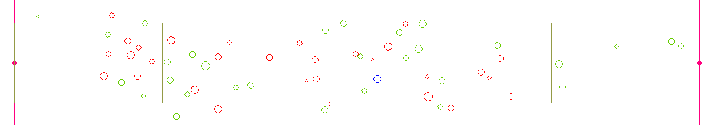
13 m
7 m
47 m

Slide 19
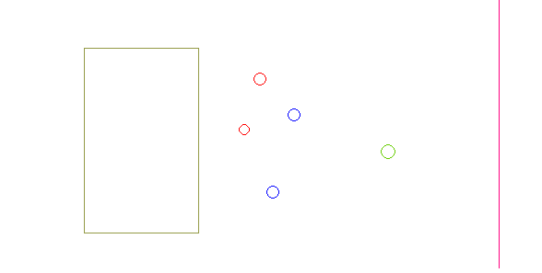
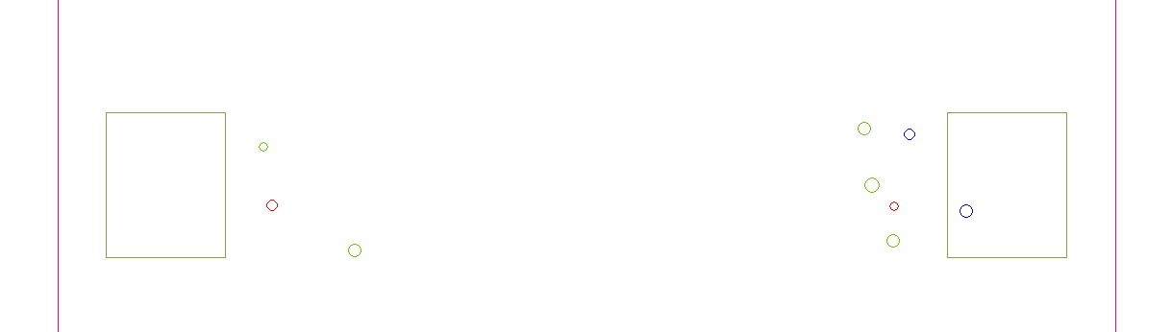
6 m
8 m
13 m
37 m
5 m
6 m
37 m

Slide 20
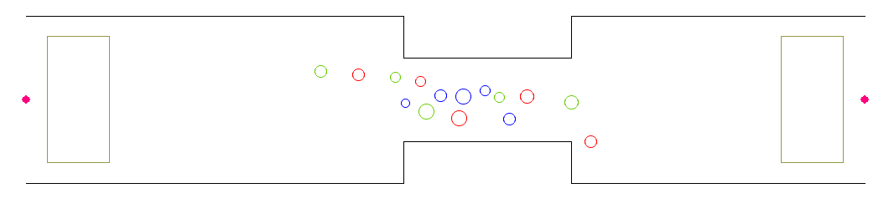
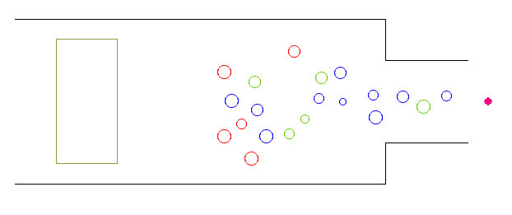
3 m
36 m
6 m
8 m
2 m
2 m
18 m
8m
14 m
18 m
2 m
4 m
4 m
8 m
6 m
2 m
3 m
18 m

Slide 21
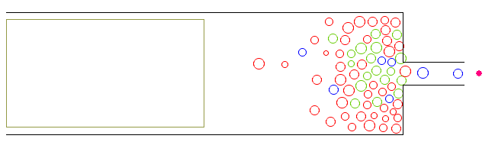
26 m
4 m
8 m
1.5 m
7 m
3.25 m
13 m
18 m

Slide 22
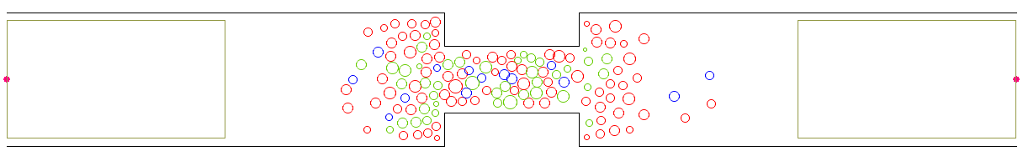
26 m
8m
8 m
7 m
2 m
13 m
47 m

Slide 23
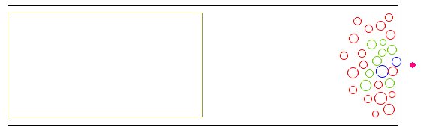
13 m
8 m
7 m
1 m
26 m

Slide 24

13 m
8 m
8 m
7 m
2 m
34 m

Slide 25
Sensors in Action
Offline
Live event
Mobile
Data source
Crowd Model Configuration on micro level
Adaptive Crowd Modelling
Pre-processing
Virtual Reality
Emergency Data Collection
Micro level
Macro level
Mobile Data Report Platform
Traffic flow nearby
Crowd flow via Camera Surveillance
Crowd Sensors
Big Data Architecture

